Slide 1
Unidata’s TDS Workshop TDS Overview – Part II
22-24 October 2012

Slide 2
THREDDS Data Server
Servlet Container
catalog.xml
Remote Access
Client
THREDDS Server
WCS
OPeNDAP
HTTPServer
WMS
NetCDF-Java
Library
configCatalog.xml
IDD Data
Datasets
thredds.ucar.edu

Slide 3
THREDDS Data Server
Servlet Container
catalog.xml
Remote Access
Client
THREDDS Server
WCS
OPeNDAP
HTTPServer
WMS
NetCDF-Java
Library
configCatalog.xml
IDD Data
Datasets
thredds.ucar.edu

Slide 4
Common Data Model (CDM)
Implemented in the netCDF-Java library (3 layers)
NetCDF Data Access:
Access to array-based scientific data (netCDF data model)
Read various file formats, map into data model (IOSP)
NetcdfDataset:
Geospatial coordinate systems (conventions)
NcML: Modify existing dataset
Aggregation of datasets
Scientific Feature Types, e.g.:
Gridded Data; Radial Data; Swath Data
Discrete Sampling Features:
Point Data; Station Data; Profile Data
Trajectory (e.g., aircraft track) Data

Slide 5
Application
Scientific Feature Types
Datatype Adapter
NetCDF-Java/
CDM architecture
NetcdfDataset
CoordSystem Builder
NetcdfFile
THREDDS
I/O service provider
Catalog.xml
OPeNDAP
NetCDF-3
NIDS
NetCDF-4
GRIB
NcML
HDF5
GINI
Nexrad
DMSP

Slide 6
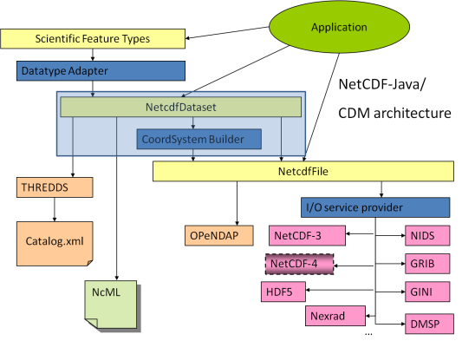
Coordinate Systems
Used to geolocate data
Dataset must describe the coordinate systems used
Use conventions to describe coordinate systems
CF Convention (recommended)
Other conventions are recognized by netCDF-Java library
What you get if your data follows conventions
Standard visualization, debugging, and data manipulation tools
Standard servers to make your data remotely accessible

Slide 7
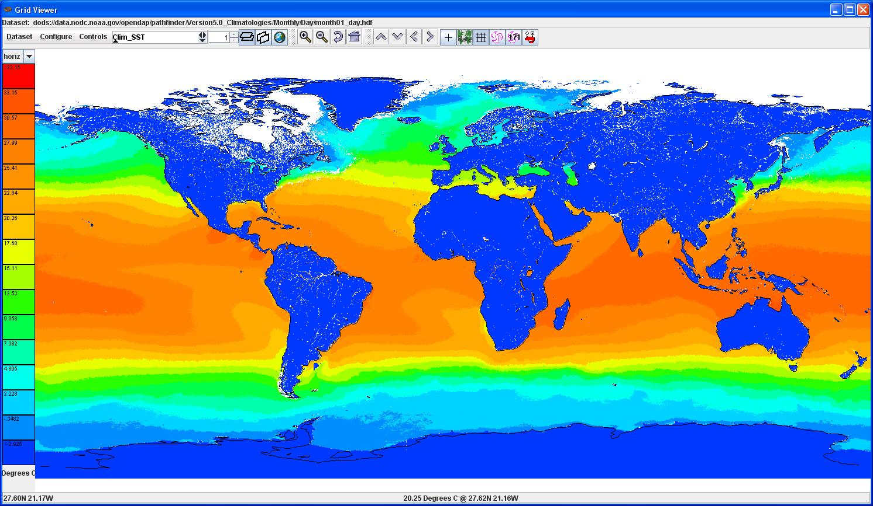
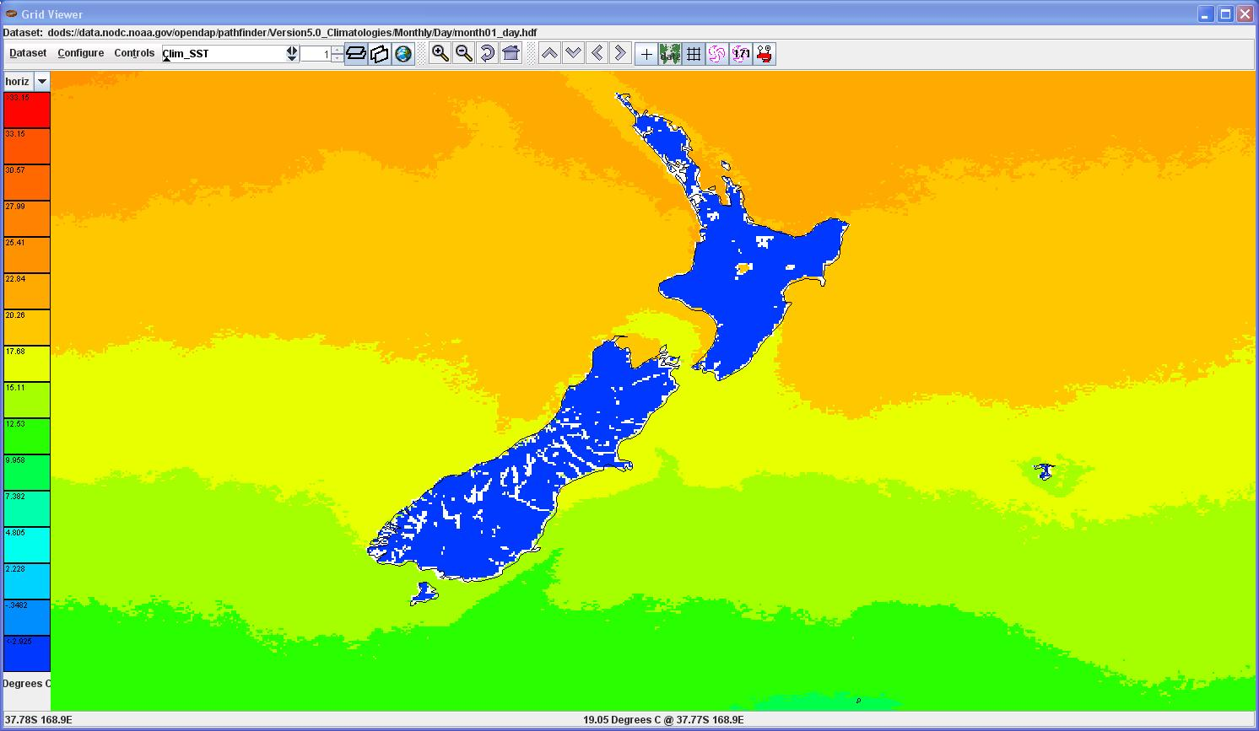
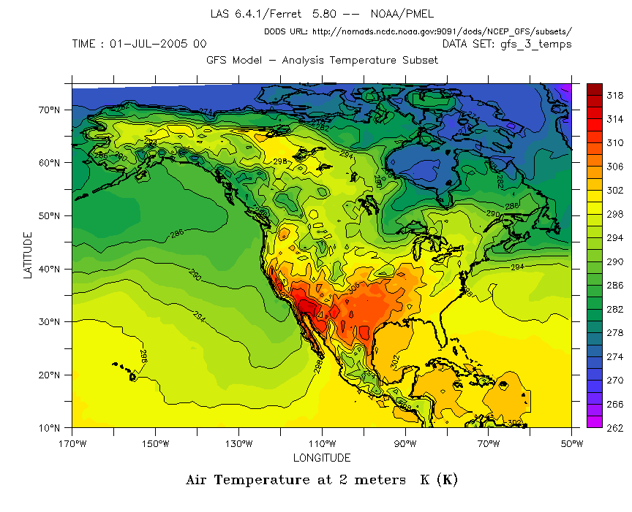
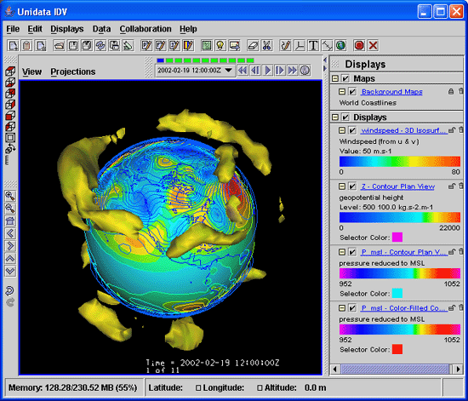
Coordinate Systems

Slide 8
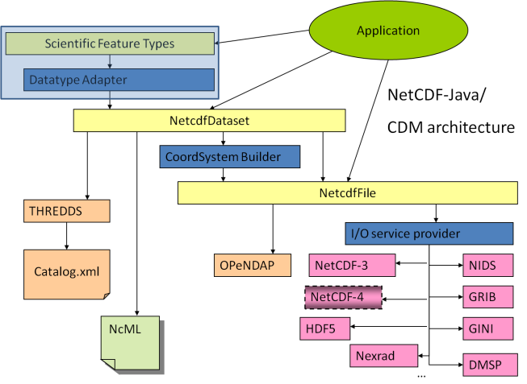
Scientific Feature Types
Gridded Data
Radial Data
Swath Data
Discrete Sampling Features
Point data
Station data
Profile data
Trajectory (i.e., aircraft track) data

Slide 9
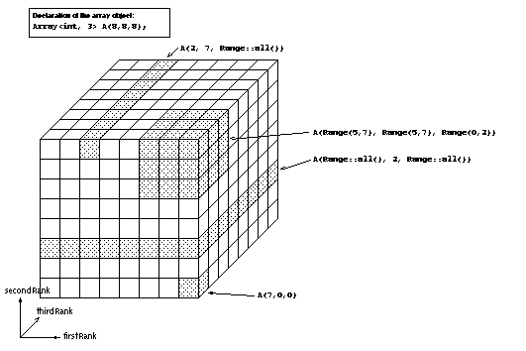
Gridded Data
Cartesian coordinates
Data is 2,3,4D
All dimensions have 1D coordinate variables (separable)
float gridData(t,z,y,x);
float t(t);
float y(y);
float x(x);
float z(z);
netCDF: coordinate variables
OPeNDAP: grid map variables
HDF: dimension scales

Slide 10
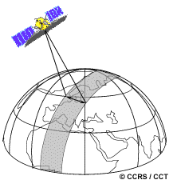
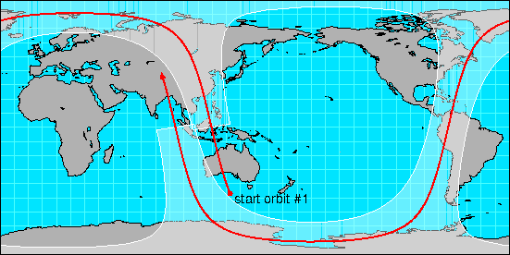
Swath
two dimensional
track and cross-track
not separate time dimension
aka curvilinear coordinates
float swathData( track, xtrack)
float lat(track, xtrack)
float lon(track, xtrack)
float alt(track, xtrack)
float time(track)

Slide 11
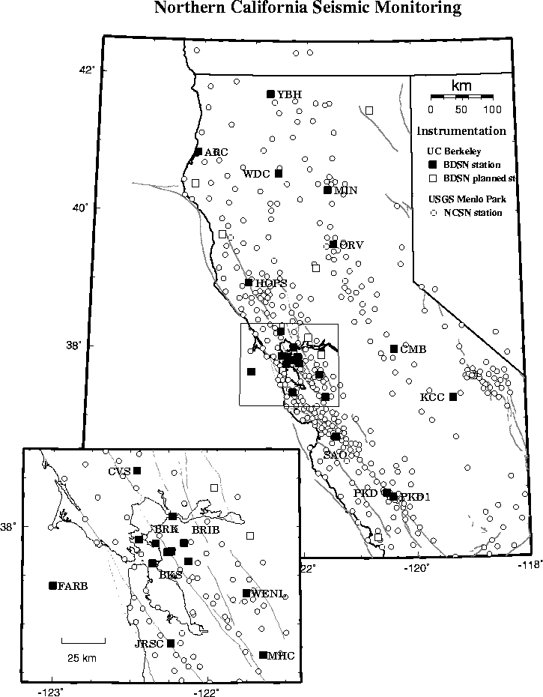
Point Observation Data
Set of measurements at the same point in space and time = obs
Collection of obs = dataset
Sample dimension not connected
float obs1(sample);
float obs2(sample);
float lat(sample);
float lon(sample);
float z(sample);
float time(sample);

Slide 12
John’s slides on CF Point Scientific Feature

Slide 13
Sean’s slides on pzhta

Slide 14
THREDDS Data Server
Servlet Container
catalog.xml
Remote Access
Client
THREDDS Server
WCS
OPeNDAP
HTTPServer
WMS
NetCDF-Java
Library
configCatalog.xml
IDD Data
Datasets
thredds.ucar.edu

Slide 15
THREDDS Data Server
Servlet Container
catalog.xml
Remote Access
Client
THREDDS Server
WCS
OPeNDAP
HTTPServer
WMS
NetCDF-Java
library
configCatalog.xml
Datasets
IDD Data
motherlode.ucar.edu

Slide 16
Data Access Services
Bulk File Transfer
HTTP Server (any file)
Remote access, subsetting CDM files
OPeNDAP (any* CDM file)
Web Coverage Service (grids)
Web Map Service (grids)
Others
NetCDF Subset Service (grids)
Radar Collection Subset Service
CDM Remote Service

Slide 17
Data Access Services Clients
OPeNDAP (lots, including IDL, MatLAB)
WCS (still minimal, but expect to grow)
GDAL, CADCorp, George Mason, OWSLib
WMS (speak WMS; consume GIF, JPEG, and PNG)
Browsers, Portals, ARC GIS, Google Earth, etc
NetCDF Subsetter
HTML forms interface
Web service (CUAHSI)
ESRI ArcGIS (manual download of netcdf-CF)

Slide 18
OPeNDAP Service
Protocol for remote, subset access to CDM files
Current version 2.0; NASA ESE standard
Working on new 4.0 protocol spec
TDS can serve any* CDM file
Subsetting by variable, index range

Slide 19
OGC Web Coverage Service (WCS)
TDS supports WCS 1.0
Can subset the dataset by:
Lat/lon or projection bounding box
time and vertical coordinate range
list of Variables
Return formats
GeoTIFF floating point, grayscale
NetCDF/CF-1.0
No reprojections, resamplings
Restricted to Gridded Datasets the CDM recognizes
Additional WCS restriction:
Grid must be evenly spaced in x,y

Slide 20

Web Map Service (WMS)
GetCapabilities -> metadata
GetMap -> map image, based on client-selected parameters, inc:
Image width/height
Image coordinate reference system
Geographic bounding box
Depth/height and time
Style
GetFeatureInfo -> information about a particular map pixel
Format not standardized
Specification supports 4D data (although tools often do not)

Slide 21
OGC Web Map Service (WMS)
TDS WMS:
Based on ncWMS (Jon Blower, U of Reading)
Supports 1.3.0 and 1.1.1
ncWMS notable features
Fast generation of images
Ability to read CDM datasets on variety of projections
Can reproject images into large number of coordinate systems
Uses geotoolkit’s extensive projection library
WMS specification supports 4D data (tools often do not)

Slide 22
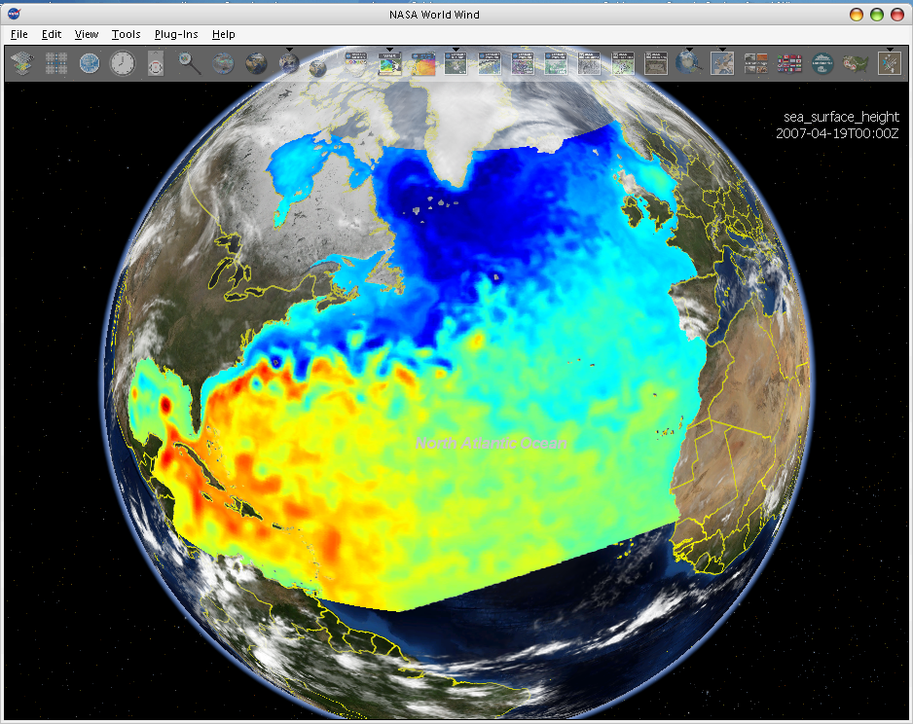
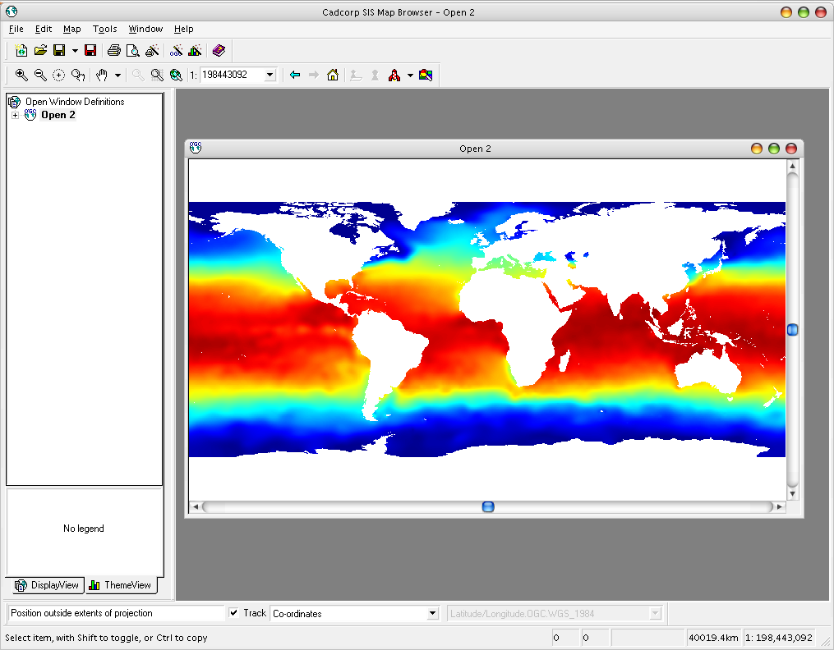
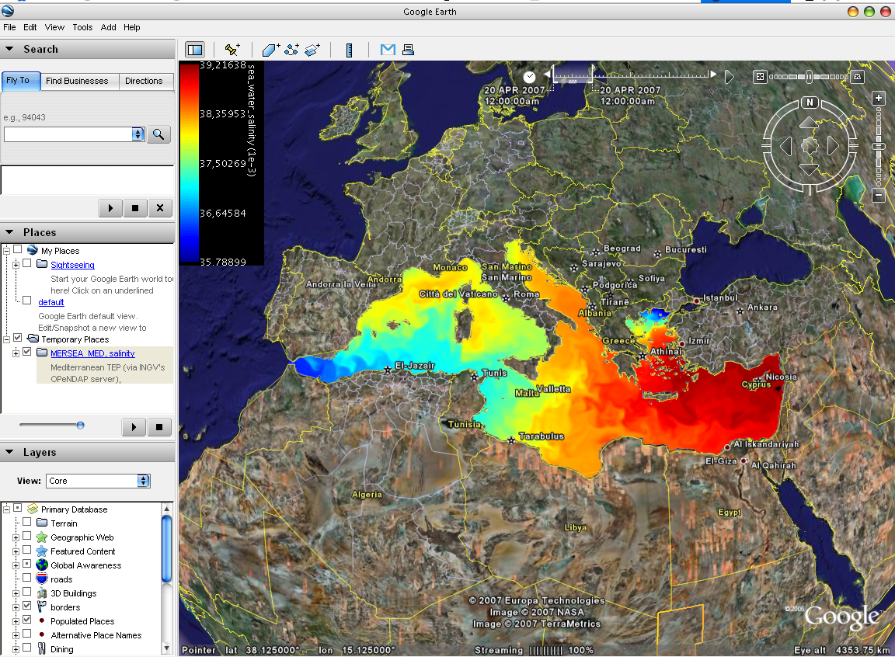
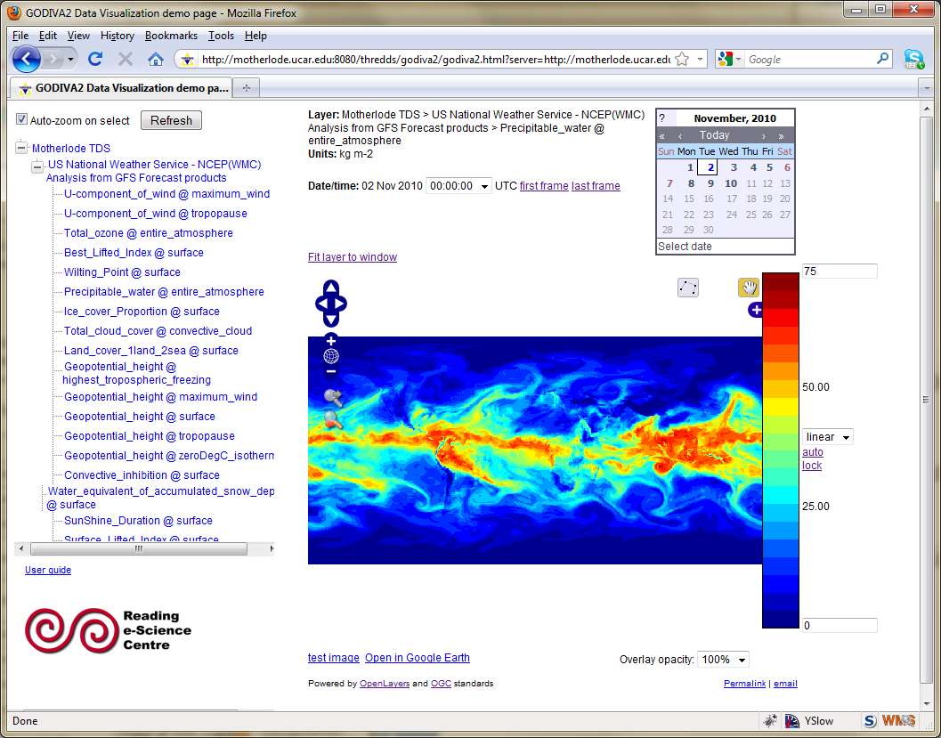
WMS Interoperability
NASA World Wind
3rd-party clients can’t use the custom WMS extensions
Cadcorp SIS
Google Earth
Godiva 2

Slide 23
NetCDF Subset Service
Experiment with REST style web service
Allow to subset the dataset by:
Lat/lon bounding box
time and vertical coordinate range
list of Variables
Output: NetCDF, XML, CSV (spreadsheet)
Gridded Data
Output is a CF / netCDF file
Variation of WCS (simplified request protocol)
Grid as Point Datasets
Extract vertical profile, time series from one point in model data
Station Data: metars (7 day rolling archive)

Slide 24
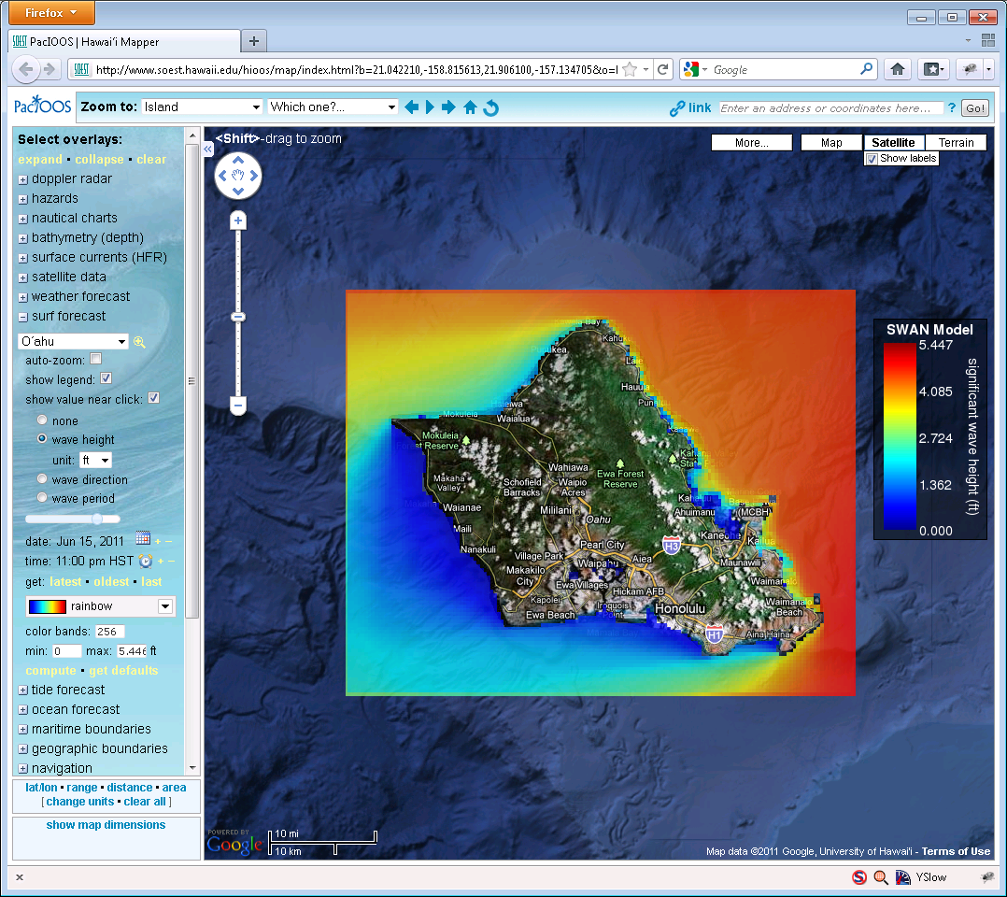
Using WMS and NCSS
* From PacIOOS site, developed by John Maurer, U of HI

Slide 25
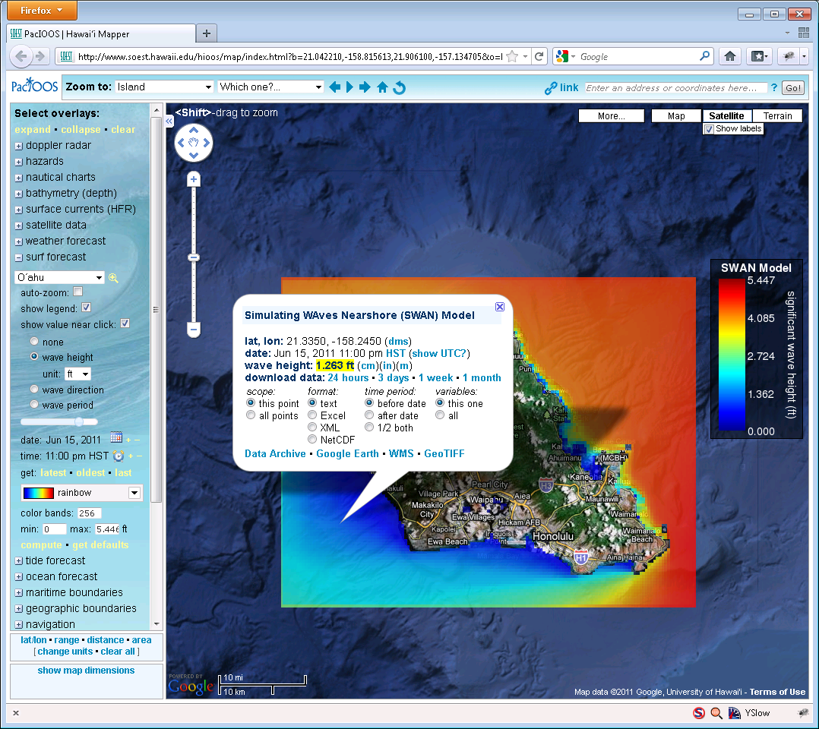
Using WMS and NCSS
* From PacIOOS site, developed by John Maurer, U of HI

Slide 26
ncISO
Developed by NOAA/NGDC
Supports three metadata services
Provides an NcML representation of a dataset
Provides an ISO 19115-2 metadata representation of a dataset
Provides an evaluation of how well the metadata contained in the dataset conforms to the NetCDF Attribute Convention for Data Discovery (NACDD)
Harvesting tools: GI-Cat

Slide 27
Marcos’ slides on ncISO/discovery
and web/mobile UI using web API (ncss & WMS)

Slide 28

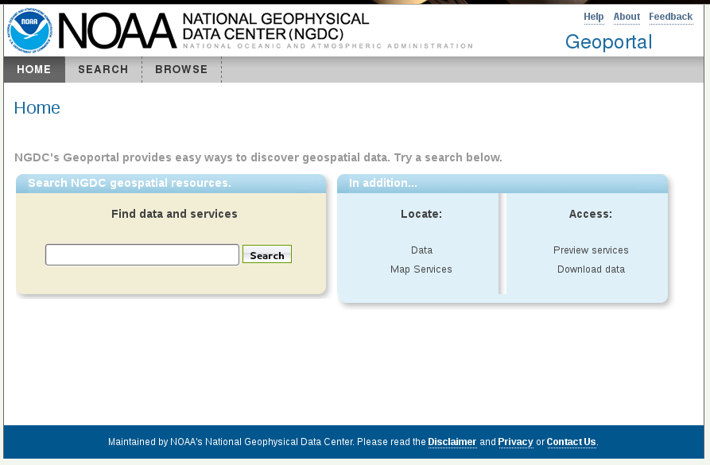
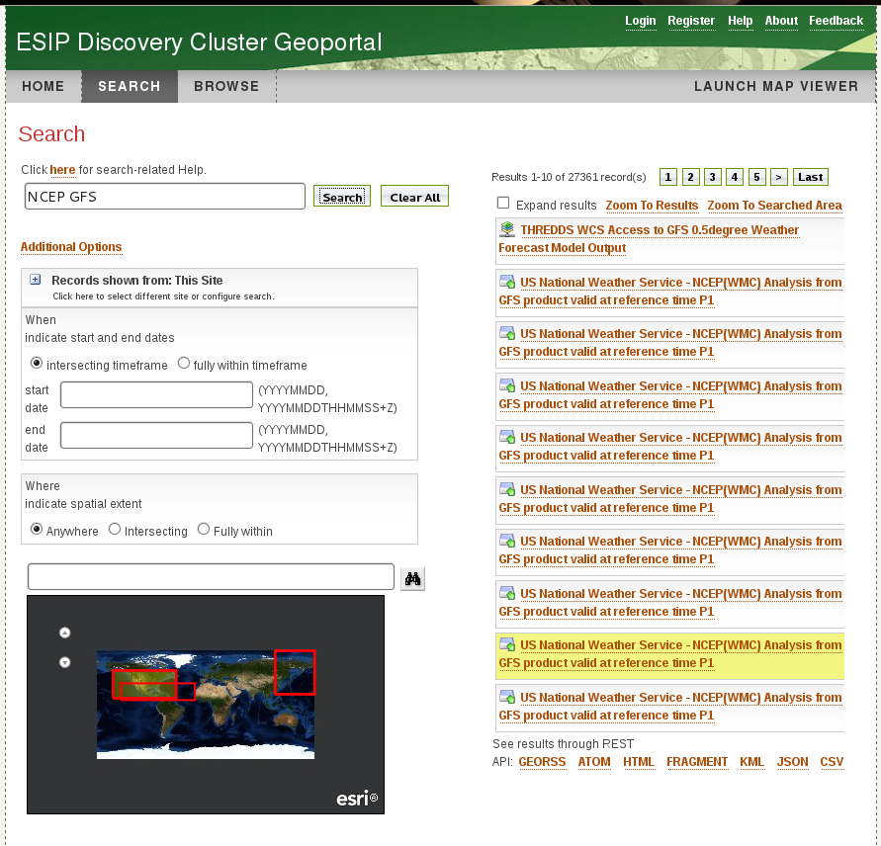
Metadata & ncISO services
Enables discovery systems to perform searches on TDS instances

Slide 29
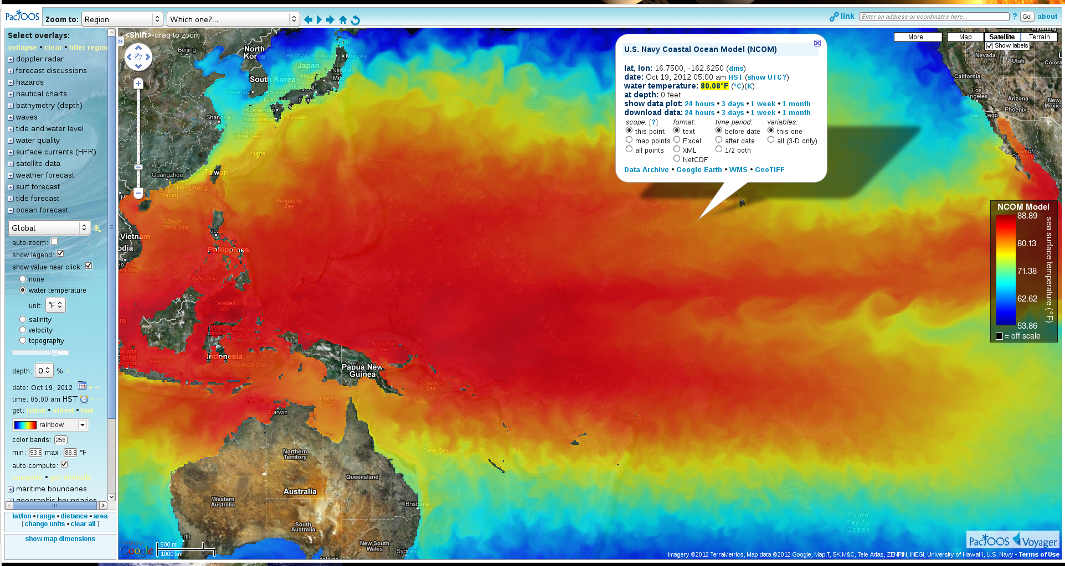
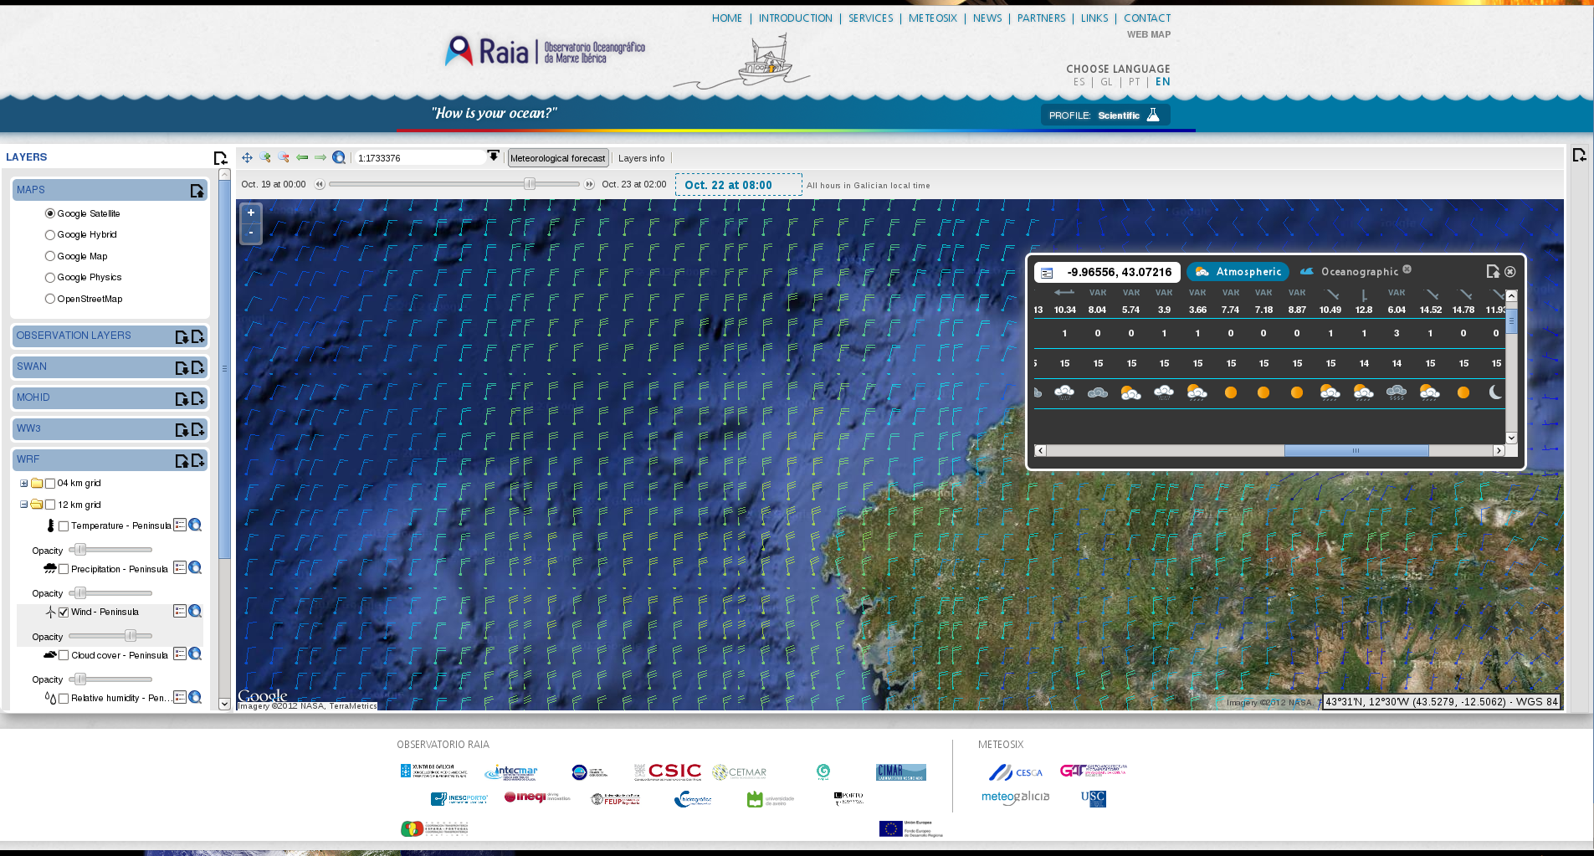
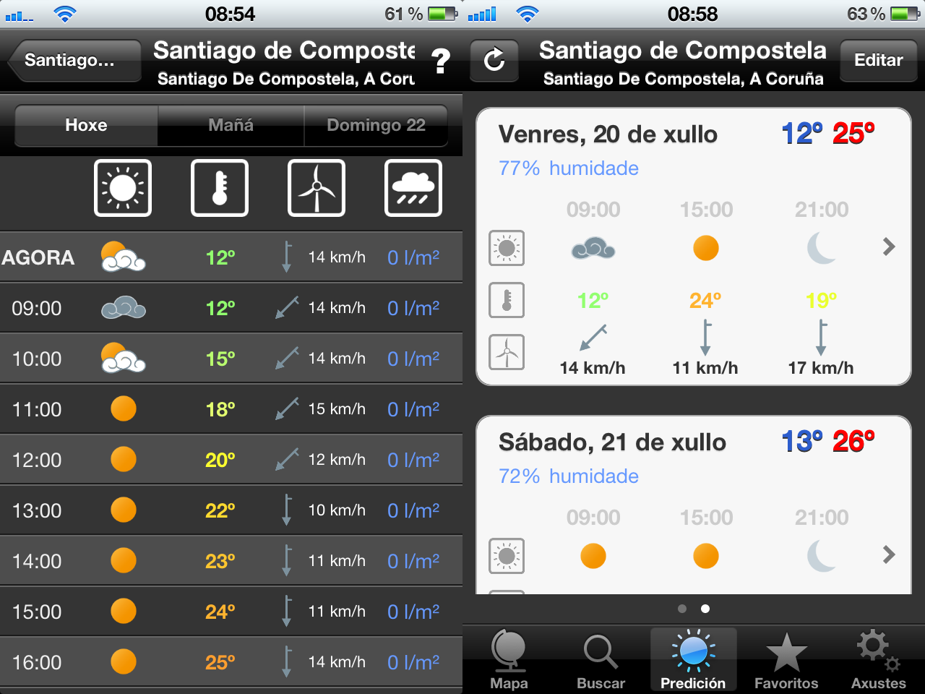
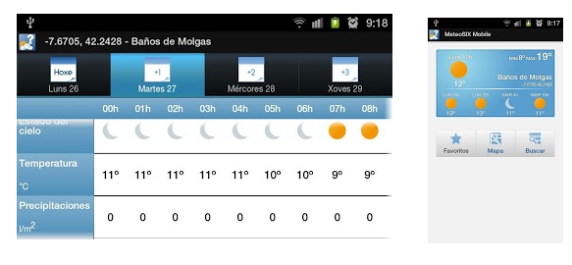
NetCDF Subset Service (NCSS)
- API for subsetting datasets

Slide 30
THREDDS Data Server
Servlet Container
catalog.xml
Remote Access
Client
THREDDS Server
WCS
OPeNDAP
HTTPServer
WMS
NetCDF-Java
Library
configCatalog.xml
IDD Data
Datasets
thredds.ucar.edu

Slide 31
THREDDS Data Server
Servlet Container
catalog.xml
Remote Access
Client
THREDDS Server
WCS
OPeNDAP
HTTPServer
WMS
NetCDF-Java
library
configCatalog.xml
Datasets
IDD Data
motherlode.ucar.edu

Slide 32
Configuration Catalogs
Administrator tells the TDS which / how datasets are to be served
Identify the files on disk
Name, organize, sort, filter into virtual collections
Add discovery metadata
Integrated with NcML
Create virtual datasets

Slide 33
TDS Configuration Catalogs
…
<datasetScan name="Ocean Satellite Data“
path="/data/ocean/sat/"
location= "/data/tds/netcdf/">
<metadata inherited="true">
<serviceName>odap</serviceName>
<dataType>Grid</dataType>
<dataFormat>NetCDF</dataFormat>
<documentation xlink:href="http://ncep.noaa.gov/modelinfo/index.html"
xlink:title="NCEP Model documentation" />
<documentation type="processing_level">
Transmitted through Unidata Internet Data Distribution.
</documentation>
</metadata>
</datasetScan>
…

Slide 34
TDS and NcML
NcML: an XML representation of netCDF.
Can “fix” metadata problems
Can augment metadata
Can aggregate datasets
General Aggregations: joinNew, joinExisting, Union
Specialized aggregations:
Forecast Model Run Collection (FMRC)
Point Feature Collections
Embed NcML into the TDS configuration catalog
Server serves a virtual dataset defined by NcML
NcML hidden from the client
Notes:
The TDS can use NcML to wrap datasets that are being served, adding or fixing metadata. The client doesn’t see the NcML, it sees only the dataset the NcML describes. The NcML aggregation capability is what the TDS uses as the replacement to the old OPeNDAP aggregation server.

Slide 35
TDS / NcML Modify and serve through TDS
<dataset name=“Polar Orbiter Data" urlPath =“idd/sat/PolarData“ >
<netcdf location="/data/sat/P02393.hdf”>
<attribute name="Conventions" value="CF-1.4"/>
<variable name="Reflectivity" orgName=“R34768”>
<attribute name="units" value=“dBZ" />
<attribute name=“coordinates" value=“time lat lon" />
</variable>
</netcdf>
</dataset>

Slide 36
THREDDS Data Server
Servlet Container
catalog.xml
Remote Access
Client
THREDDS Server
WCS
OPeNDAP
HTTPServer
WMS
NetCDF-Java
library
configCatalog.xml
Datasets
IDD Data
motherlode.ucar.edu

Slide 37
Status: CDM/netCDF-Java & TDS
netCDF-Java/TDS 4.2
Stable since November 2010
netCDF-Java/TDS 4.3
Stable version expected September 2011
Changes from netCDF-Java/TDS 4.2
Improved handling of very large GRIB-2 collections
GRIB-2 code refactored
Special Feature Collection for GRIB-2
Start using Joda Time (support various calendars)
Upgrade to latest ncWMS code
Tomcat 7 will be required (due to Spring 3 dependency)

